Slide 1

BiG Data
Professor: Prem Nair
Student: Van Vong Tran

Slide 2
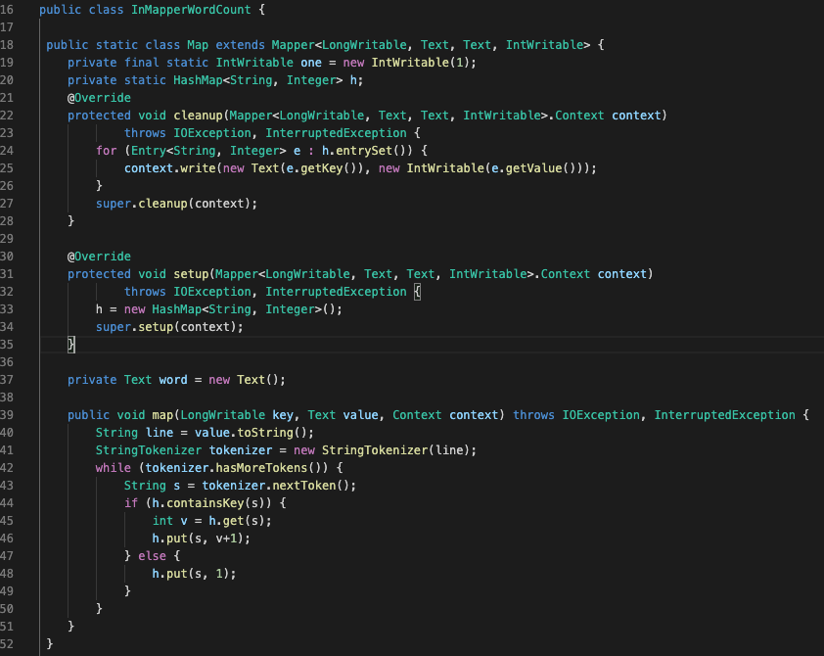
Part 1: In MAPPER Java code - Mapper - C: Word count

Slide 3
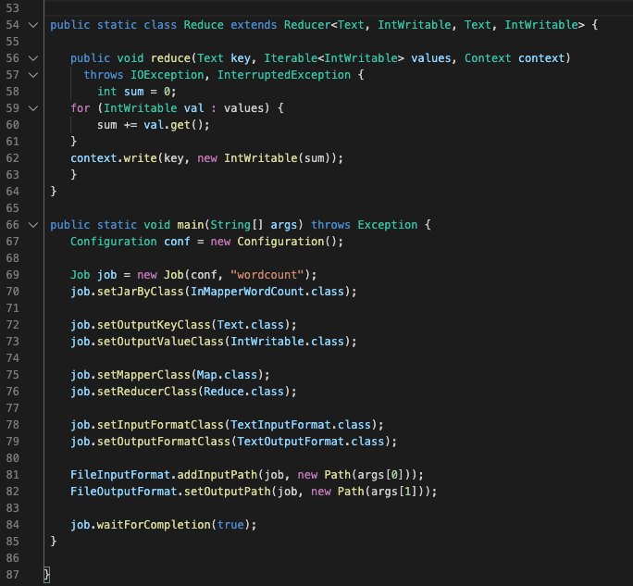
Part 1: In MAPPER Java code - Reducer - C: Word count

Slide 4
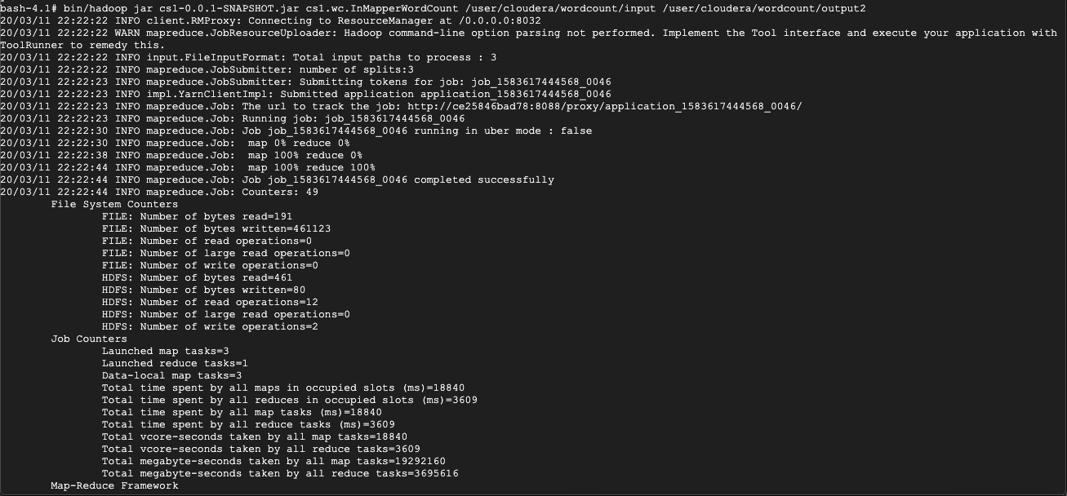
Part 1: - D: In MAPPER Word count - Execution

Slide 5
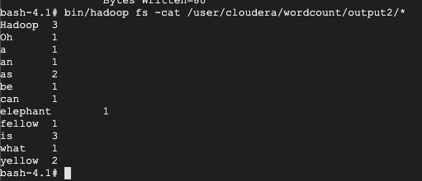
Part 1: - d: IN Mapper Word count - result

Slide 6
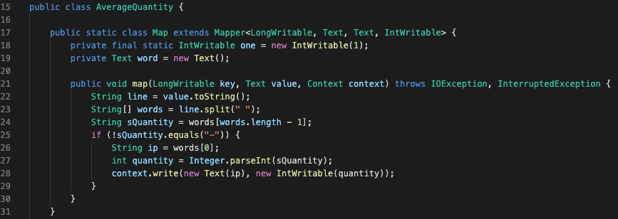
Part 1: - E: Average Computation - Java code – Mapper class

Slide 7
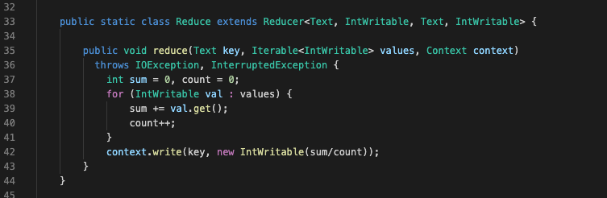
Part 1: - E: Average Computation - Java code – Reducer class

Slide 8
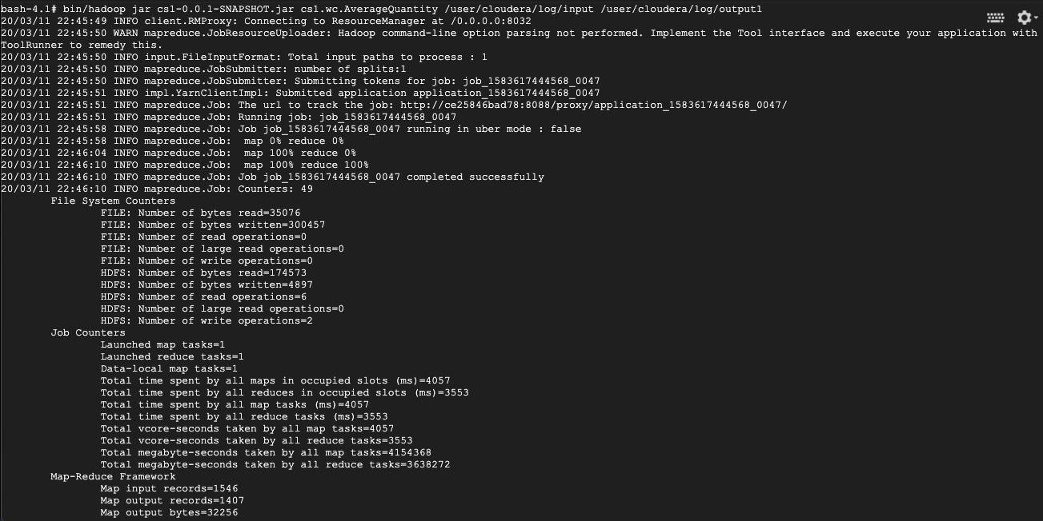
Part 1: - E: Average Computation - Execution

Slide 9
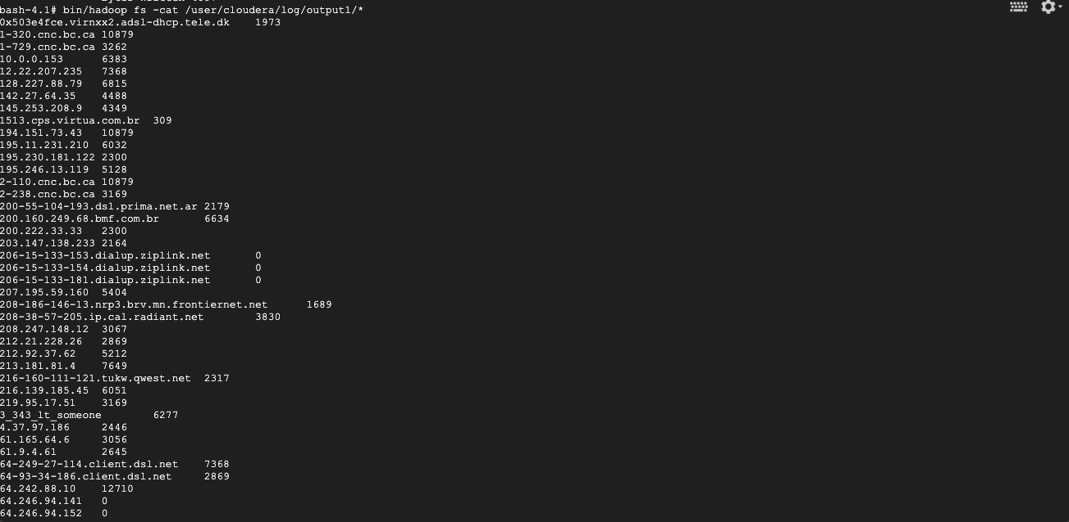
Part 1: - E: AVERAGE COMPUTAtION -result

Slide 10
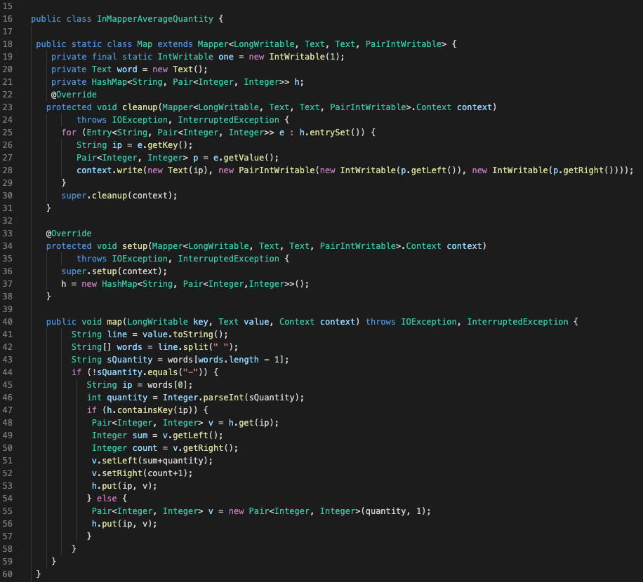
Part 1: - E: IN MAPPER Average Computation - mapper java code

Slide 11
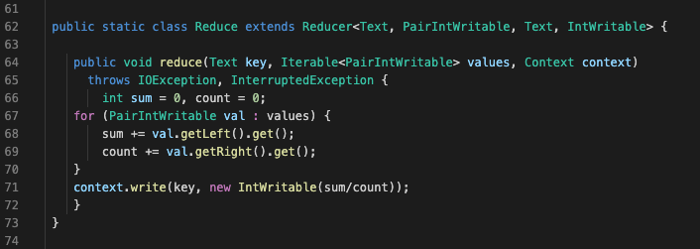
Part 1: - E: IN MAPPER Average Computation - reducer java code

Slide 12
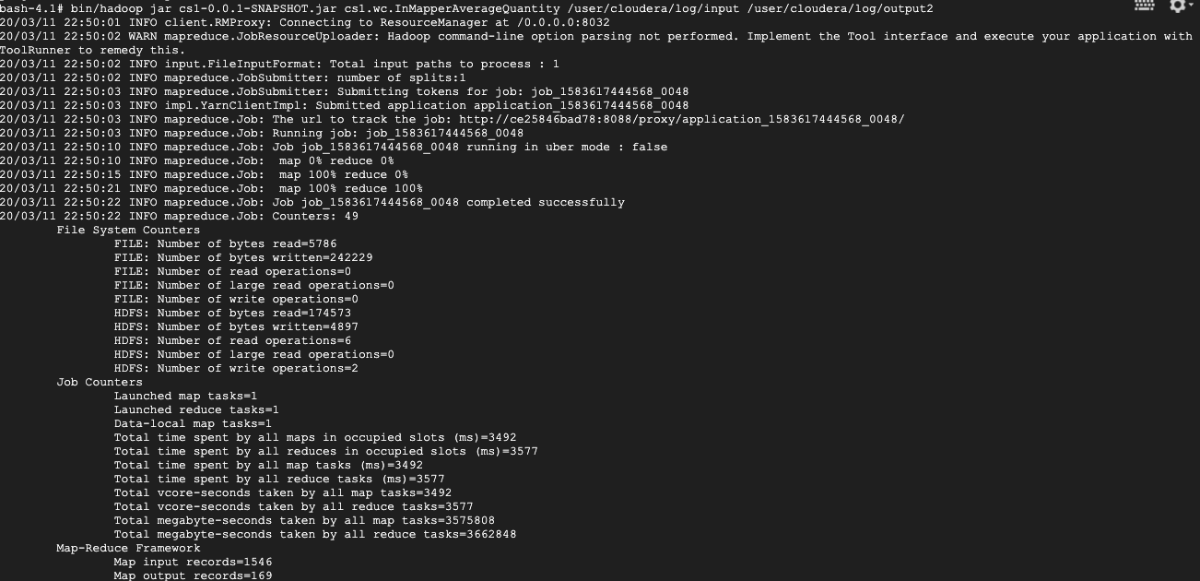
Part 1: - E: IN MAPPER Average Computation

Slide 13

Part 1: - E: COMBINING AVERAGE COMPUTAtION -result

Slide 14
Part 2: Pair relative - A: Sudo code
Class Mapper
Method map(docid a, doc d)
For all words u in document d do
For all words v in Window(u) do
Emit((u, v), 1)
Emit((u, *),1)
Class Reducer
Method initialize()
Total = 0
Method reduce(pair(u, v), integer[c1, c2, …])
Sum = 0
For all interger c in [c1, c2, …] do
Sum += c
If (v == *) total = sum
Else Emit((u, v), sum/total)

Slide 15
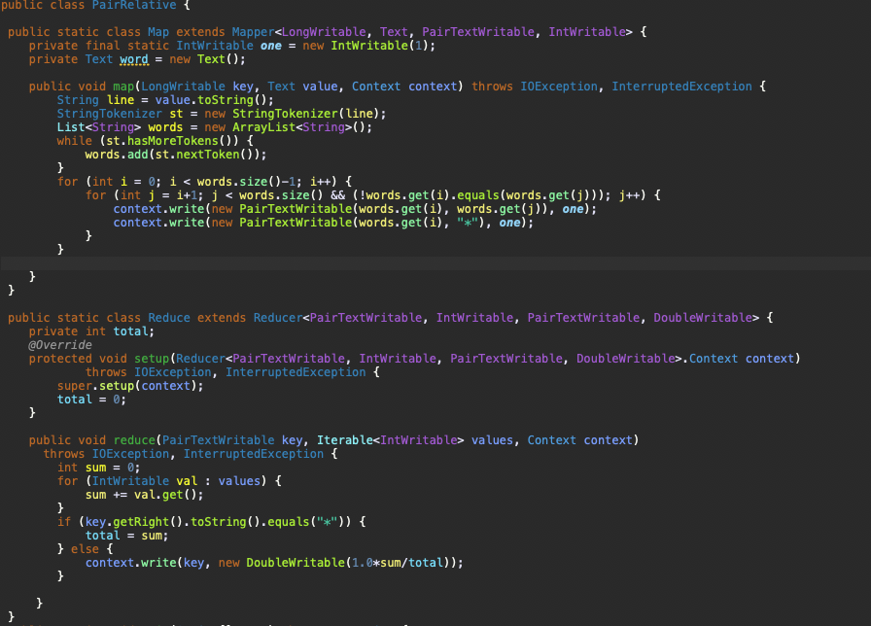
Part 2: Pair relative - A: java class

Slide 16
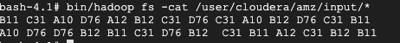
Part 2: Pair relative - B: INPUT

Slide 17

Part 2: Pair relative - B: Execution

Slide 18
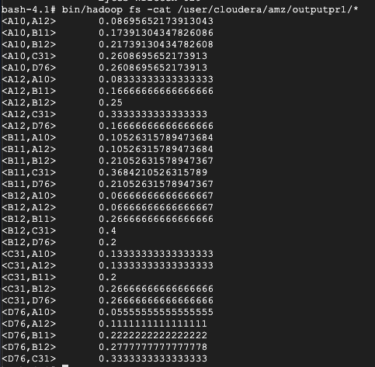
Part 2: Pair relative - B: ReSULT

Slide 19
Part 3: Stripe relative - A: Sudo code
Class Mapper
Method map(docid a, doc d)
For all words u in document d do
H = new AssociativeArray()
For all words v in Window(u) do
H{v}++
Emit(u, H)
Class Reducer
Method reduce(String key, AssociativeArray[H1, H2, …])
Hfn = new AssociateArray()
For all AssociativeArray H in [H1, H2, …] do
Hfn = Hfn + H
Sum = sum(Hfn)
Hfn = Hfn/sum
Else Emit(u, Hfn)

Slide 20
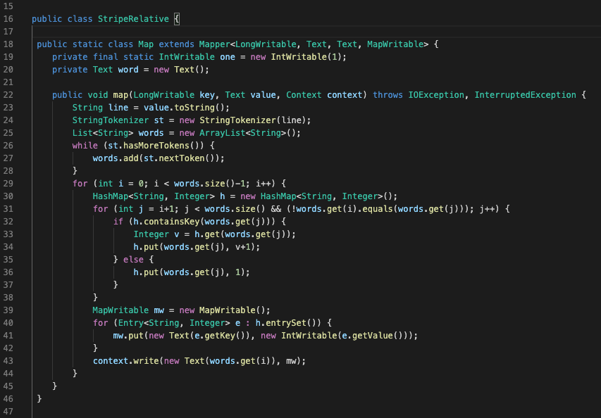
Part 3: STRIPE relative - A: java class- Mapper

Slide 21
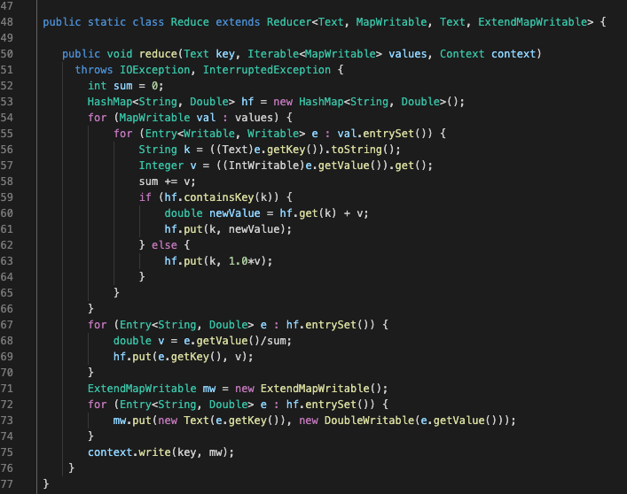
Part 3: STRIPE relative - A: java class- reducer

Slide 22
Part 3: STRIPE relative - B: INPUT

Slide 23
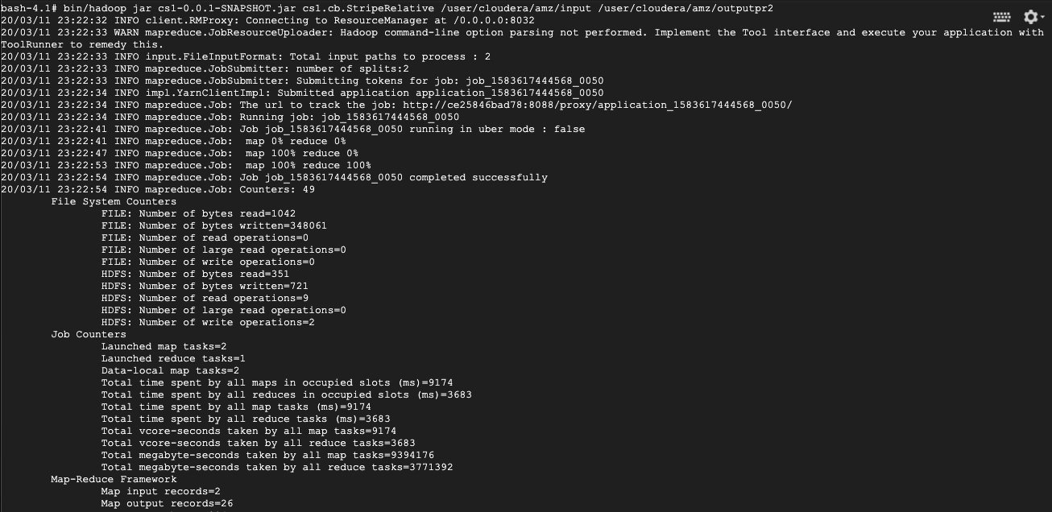
Part 3: Stripe relative - B: EXECUtion

Slide 24
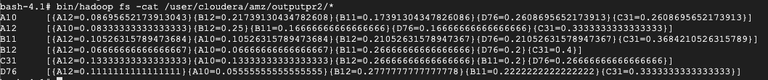
Part 3: Stripe relative - B: ReSULT

Slide 25
Part 3: HYbrid relative - A: Sudo code
Class Mapper
Method map(docid a, doc d)
For all words u in document d do
H = new AssociativeArray()
For all words v in Window(u) do
Emit((u, v), 1)
Class Reducer
Method initialize()
H = new AssociativeArray()
String kprev = ""
Method reduce(Pair(u, v), Interger[c1, c2, …])
if (kprev != null && kprev != u)
Total = sum(H)
Emit(u, H/total)
H = new AssociativeArray()
Sum = 0
For all Integer c in [c1, c2, …] do
H{v} += sum
Kprev = u
Method clean()
Total = sum(H)
Emit(u, H/total)

Slide 26
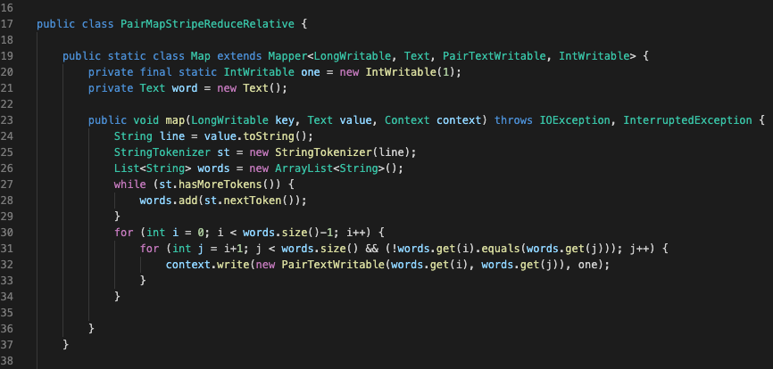
Part 4: hybrid relative - A: java class - Mapper

Slide 27
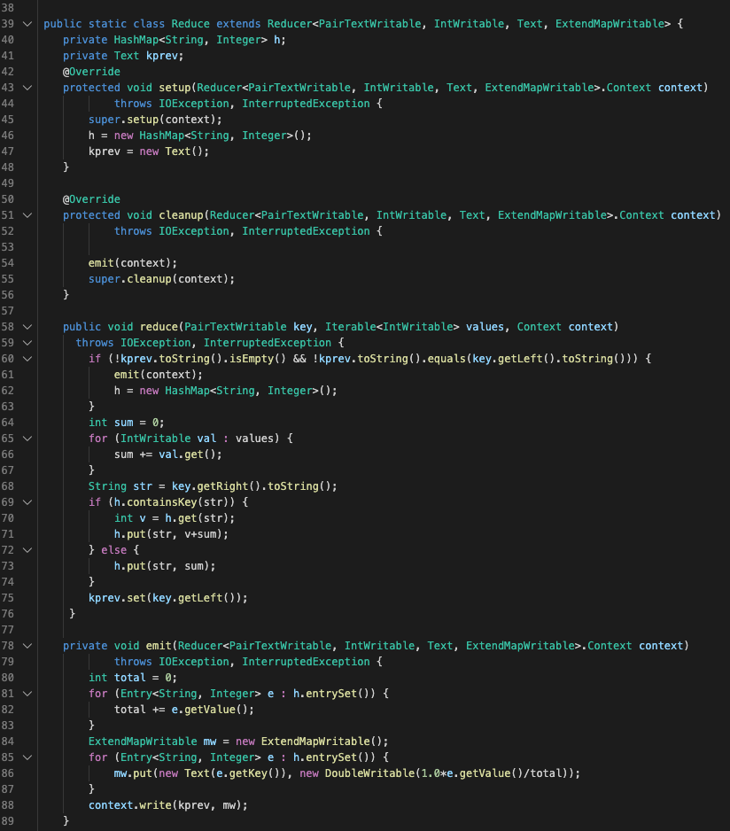
Part 4: hybrid relative - A: java class - Reducer

Slide 28
Part 4: hybrid relative - B: INPUT

Slide 29
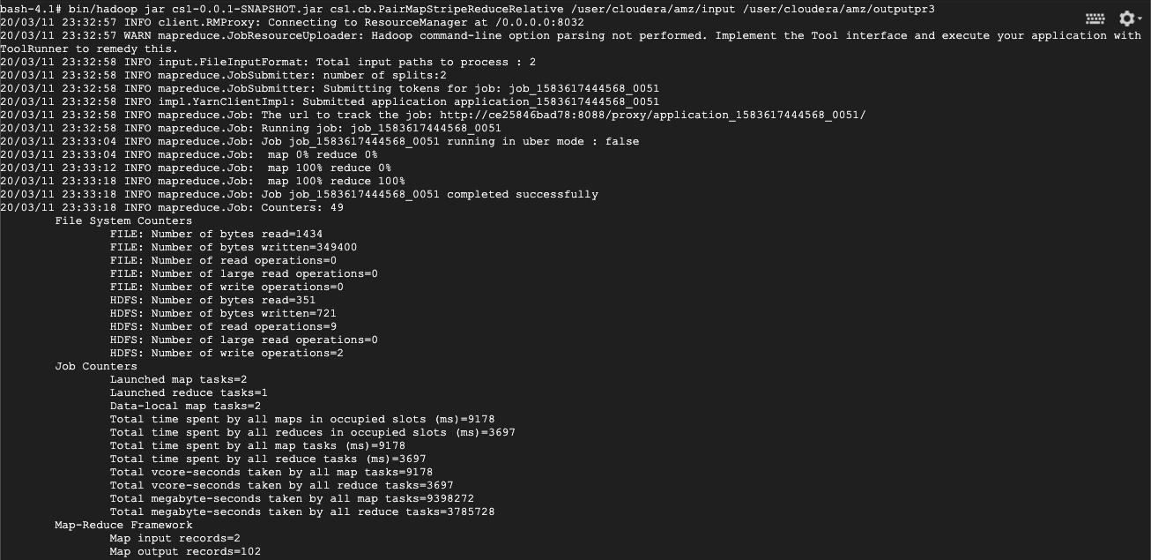
Part 4: hybrid relative - B: execution

Slide 30
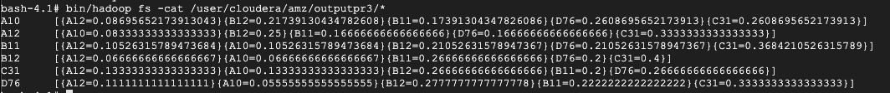
Part 4: hybrid relative - B: Result

Slide 31
Part 4: Pair – stripe - hybrid relative - B: Comparision
No | Name | Pair | Stripe | Hybrid
1 | Total time spent by all map tasks (ms) | 7324 | 6314 | 6102
2 | Total time spent by all reduce tasks (ms) | 3178 | 3103 | 3111
3 | Total megabyte-seconds taken by all map tasks | 7499776 | 6465536 | 6248448
4 | Total megabyte-seconds taken by all reduce tasks | 3254272 | 3177472 | 3185664
5 | Map input records | 2 | 2 | 2
6 | Map output records | 204 | 26 | 102
7 | Reduce input records | 204 | 26 | 102
8 | Reduce output records | 30 | 6 | 6
9 | GC time elapsed (ms) | 106 | 71 | 71
10 | CPU time spent (ms) | 2150 | 1710 | 1620
11 | Physical memory (bytes) snapshot | 665894912 | 726147072 | 665968640
12 | Virtual memory (bytes) snapshot | 4139315200 | 4167344128 | 4151328768
13 | Total committed heap usage (bytes) | 648019968 | 688390144 | 649068544

Slide 32
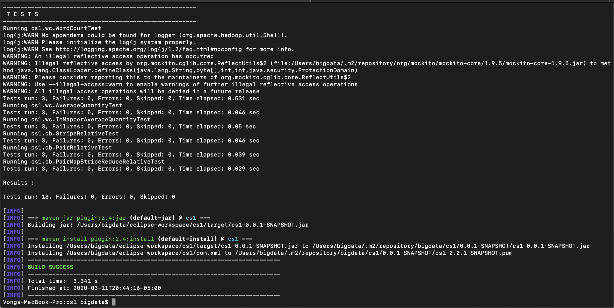
Part 4: UNIT TESTING - A: REPORT

Slide 33
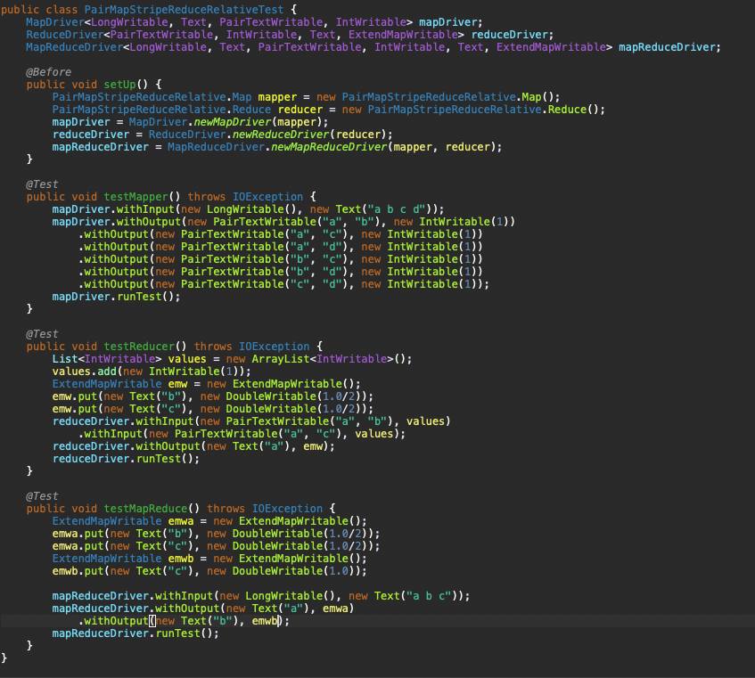
Part 4: UNIT TESTING - B: CODE

Slide 34
Part 5: spark - a: problem statement
We want to measure the mean and standard deviation values for a feature. So some reasons, we could not pick up all of data for that feature to calculate and boostraping is a statistical technique to solve this problem.
Example data at this link https://sakai.cs.miu.edu/access/content/group/cfa660b1-f8e1-4d5d-9dfe-ae1d258eaf12/Spark%20SparkSQL%20Sample%20Program/mtcars.csv
In this example, I want to show relationship between number of cylinders of a car with miles per galon. This program shows the result of mean and standard deviation of a whole data versus bootstrap sampling technique given number of sampling times

Slide 35
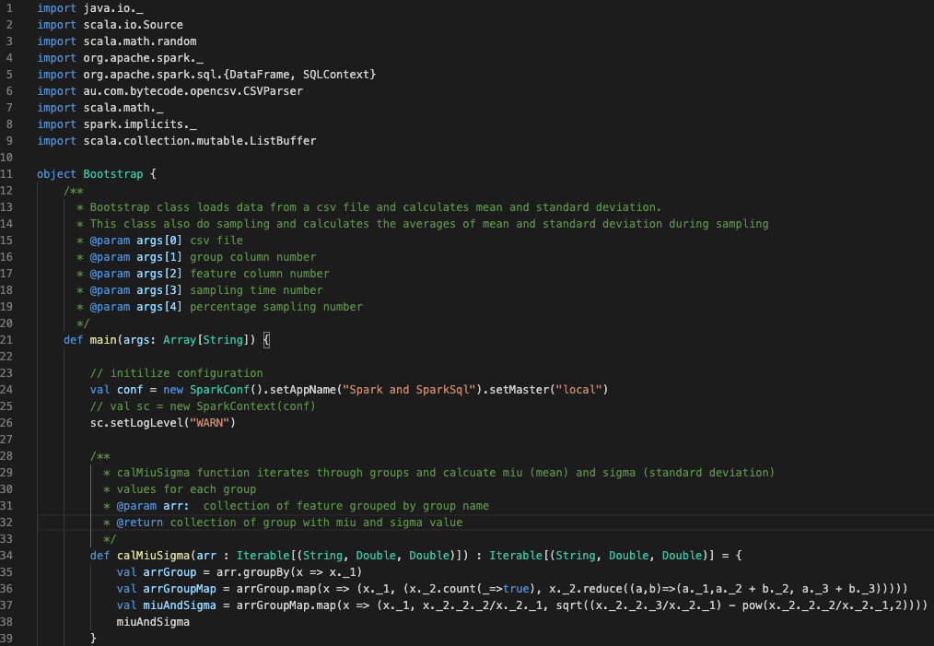
Part 5: spark - B: scala code 1

Slide 36
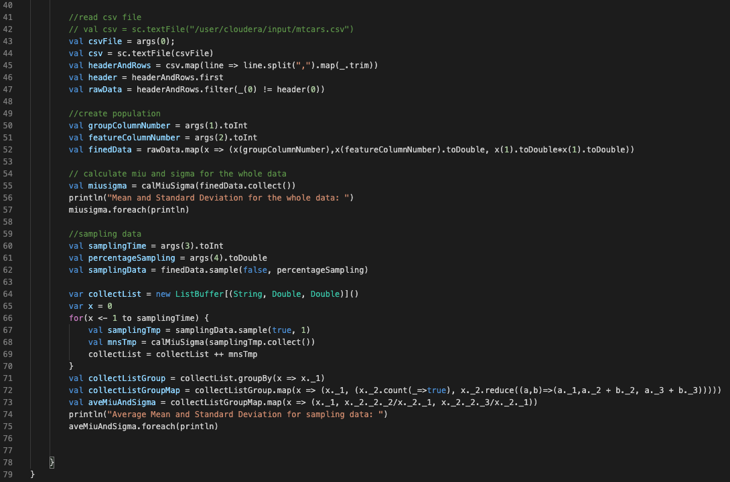
Part 5: spark - b: scala code 2

Slide 37
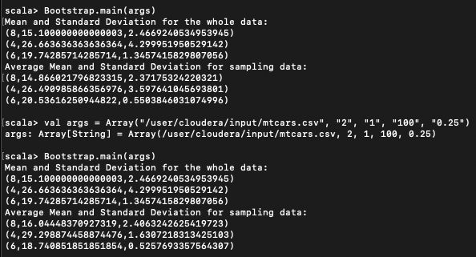
Part 5: spark - C: Result

Slide 38

Thank You!
vantran@miu.com

